Slide 1


MID TERM PROJECT

Slide 2
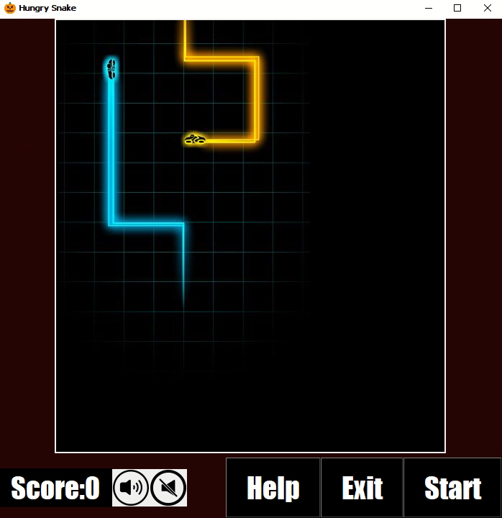
A Glimpse of the Program

Slide 3
Intended for people of all ages and sizes
Minimum user requirement.

Slide 4
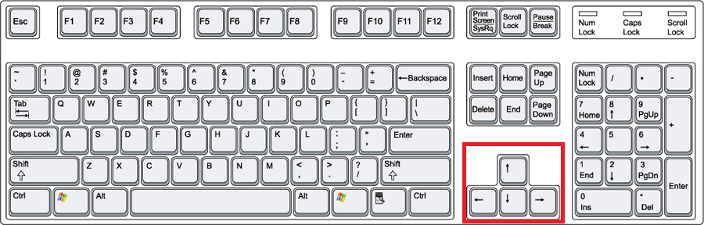
Control Buttons
4 arrows and a click are all u need.

Slide 5
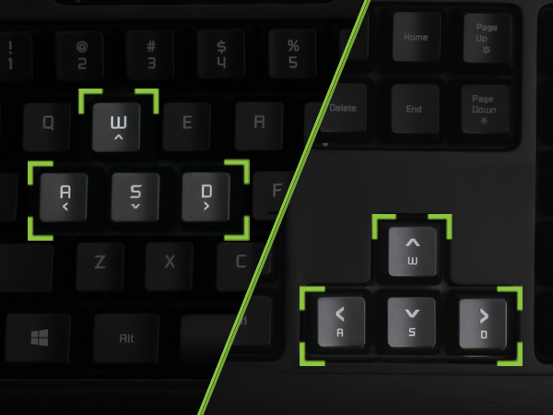
Control Buttons
Your arrow buttons are not working?
Don’t worry.
I have another option for u.

Slide 6
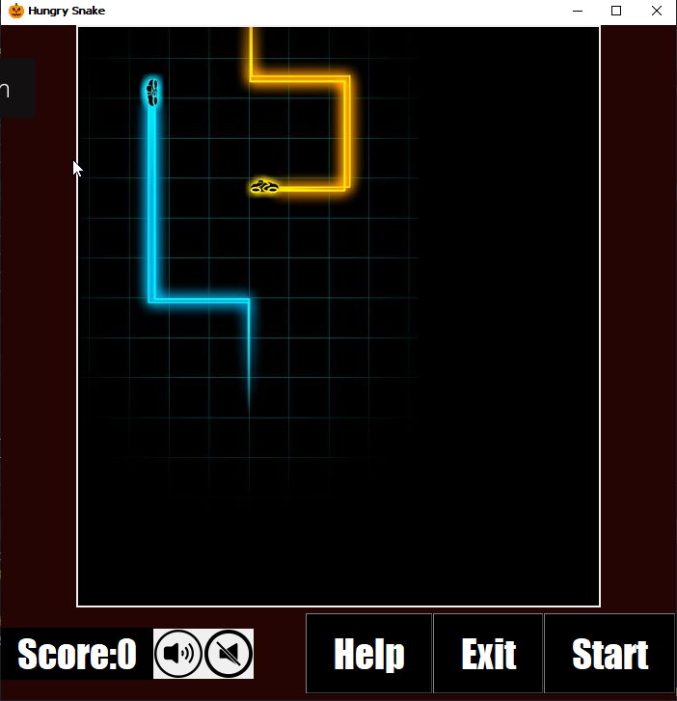
Rules of the Game
Do Eat as much as you can.
Don’t hit the wall.
Don’t eat yourself.
Warning🚨
The more u eat, the longer u become, and the faster u will run

Slide 7
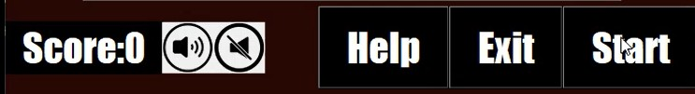
Instruction
Click START to begin the game.
Don’t know how to play? just click the HELP button.
Click EXIT to leave the game.

Slide 8
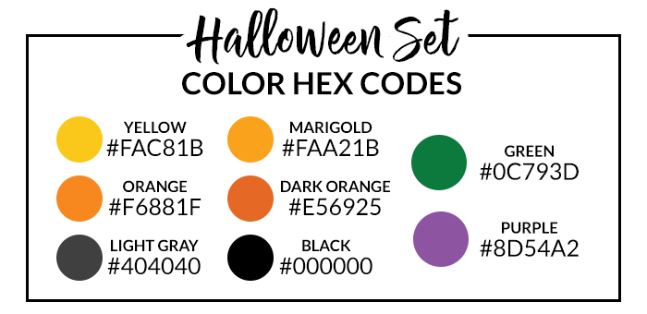
Special Features
9 different snake colors
4 different food colors.
Program with the pumpkin icon.
The live score would be presented under the game.
All under the Halloween theme.

Slide 9
And, one more

Slide 10

The background music
U can turn on… or off as you wish.
Song source: Double Trouble

Slide 11
What do I use? | Where do I use them?
Lists | -Snake Colors -Food Colors -Snake elongation (list.append)
Class | -Constructing Snake and Food to be appear on the screen
For loop | Locating and putting the snake on the canvas

Slide 12
What do I use? | Where do I use them?
If-else statements | -Making the snake turn around
Control statement | To prevent 180 degree turn of the snake
Comparison operators | To end the game when the snake hits the wall or eats it parts.

Slide 13
What do I use? | Where do I use them?
Augmented operators | Increasing the score Making the snake runs faster
Global and local variables | Manipulate them to work in the functions
Functions | To run the game To make the snake turn To turn on or off the song To kill the snake To make food disappear/ appear To call help To end the game

Slide 14
What do I use? | Where do I use them?
Casting the integers | Placing the window on a fixed display
File import | Song files and images
Boolean | To build a resizable window

Slide 15
Built in functions | Where do I use them?
Random | Food location Colors of snake and food
GUI | - Building the window and interfaces
Pygame | Add Background music

Slide 16
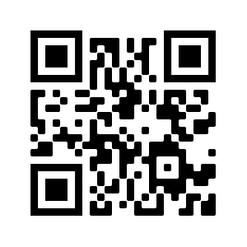
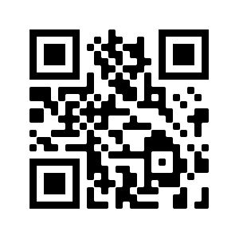
Demo Videos
Chaw Thiri San
12225272
Functionality test
Code explanation

Slide 17
Question and Answer time:

